Slide 1


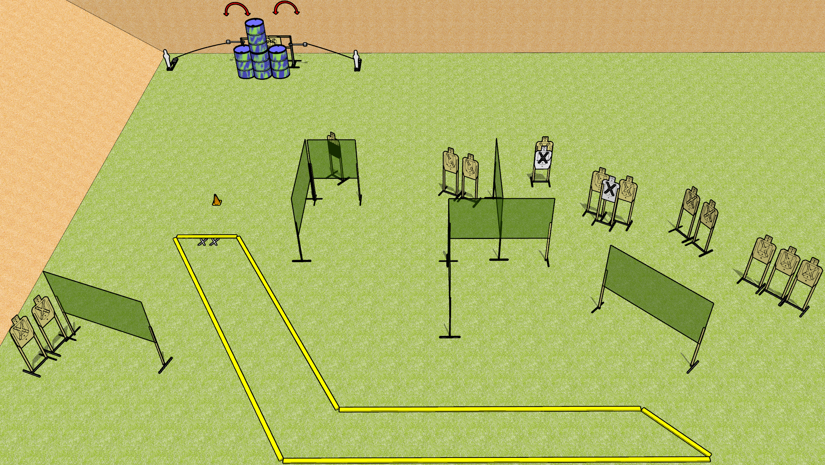
 | Dothan Gun Club – USPSA Match Back it Up Course Designer : Drew Coleman
START POSITION : Standing with both feet on X’s, wrists below belt
GUN READY CONDITION : Pistol loaded and holstered. PCC loaded, held with both hands, shouldered, safety on, pointed at orange cone. |  | SCORING: Comstock, 32 rounds TARGETS: 15 paper, 2 Steel SCORED HITS: Best 2 on paper, steel until down START-STOP: Audible, last shot RULES:
STAGE PROCEDURE: Engage targets as they become available from within the fault lines.

Slide 2
Back it Up
Written Stage Briefing
Back it Up is a 32 round, 160 point, Comstock field course. There are fifteen USPSA targets and two mini poppers. The best two hits on paper will score, and steel must fall to score. The start signal is audible.
The left swinger is activated by the left poppers, and the right swinger by the right popper. Please check the activators before walkthrough and set the same way every time.
Handgun start position is standing with both feet on X’s, wrists below belt. Handgun is loaded and holstered.
PCC start position is standing with both feet on X’s, muzzle pointed at cone. Loaded carbine is held with both hands, safety on, shouldered.
On start signal, engage the targets as they become available from within the shooting area.

